Slide 1
Oct Update

Slide 2
Flexi-TEER
Goals
First true open-source TEER meter that can replace the EVOM meter
Wireless communication, computer-based triggering and multiplexing as functions beyond stock EVOM
Easy build
Major Events
Added Dennis Yaskevich as collaborator (Electrical Engineer)
Dennis has been a major contributor.
Schematic completed and being reviewed by Jose from Jerry Turner’s lab
Dennis will route the PCB this month

Slide 3
Current Open-Source TEER projects
In short, nothing good is available. Either straight trash in execution or relies on the actual EVOM unit
Ok enough add on design that caps at 4 electrodes
Nice that it logs temp
Not actually open source as it needs and EVOM meter
Literally an Arduino w/ a resistor = trash. They claimed good accuracy, but its impossible. Should have been instantly rejected.

Slide 4
Flexi-TEER Block Diagram

Slide 5
Schematic: Power

Slide 6
Schematic: MCU

Slide 7
Schematic: Voltage Processing

Slide 8
Schematic: Electrode Multiplexer

Slide 9
Features
On board rechargeable battery. Key to make into actual portable EVOM equivalent unit
Wireless communication
Around a sub-100 dollar build
Chose cheap and in stock pick and place parts
15 electrode sequential multiplexer
On-board calibration channel (no external cal resistor needed)
10-100k Ohm range.
Fixed, but modulable current, 100uA ma.
Around 3k samples/sec possible (enough to see cap based decays)
12-bit ADC resolution
Use EVOM chopsticks if use RJ11 to RJ45 converter as wires are mapped in exact same fashion as the EVOM meter.

Slide 10
Auto Cy-Plex Formerly Auto-CIF
Key Developments
Invisi-Slip
Change of direction to micro-fluidic device
mCPBA based bleach solution
Upgrades
Ram on computer boosted from 16gb to 128gb
SSD storage space boosted from 256gb to 2tb
Level screws replaced with tilt stage
New fluidic system

Slide 11
Invisi-Slip
FEP film’s RI = 1.333, H2O RI = 1.330
Idea = FEP as effective ‘coverslip window’ will provide optimal optics in a water dipping environment
Easy idea, but difficult to manufacture
FEP film is very very slick and hard to stick adhesives to
Acton’s fluoroetch modifies surface and allows adhesives to stick
PDMS has sufficient bond to modified FEP film if cured on it.

Slide 12
Basics of design
3 components to design
Viewing window
Inlet and outlet port
Transition zones from port into viewing window area
Constraints
Overall height from slide <2mm (allows for 1.1NA objectives to be used)
Low volume over tissue (around 70uL or less)
Optically ‘Pure’ viewing window made from FEP film.
Reversible Bonding of device
Fit on 75mm X 25mm slides without touching 18mm frosted area
Ports need to be separated from viewing window spatially to prevent collision with objective
Top View
Viewing Window
Port Inlet
Port Outlet

Slide 13
Viewing Window Construction (Side View)
FEP is hard to adhere to any material
Fluoroetch from Acton can modify FEP surface and allow it to adhere
2. Spin coat PDMS up to height of mold features and partially cure it
3. Apply vacuum grease to mold feature and then place Fluoroetch treated FEP film onto mold with a predetermined and slight overhang
1. Make silicon wafer mold
4. Apply vacuum grease to bottom of SLA printed resin block that has same dimensions as viewing window. Place on FEP film directly over silicon mold feature
5. Pour PDMS onto mold to desired height and fully cure
6. Remove SLA printed spacer and then remove device from mold. Place in Hexane bath to dissolve the vacuum grease to clean up viewing window

Slide 14
Reversible Bonding
Typically, PDMS is plasma treated to covalently bond to glass. This is not acceptable as it would make them single use, need on hand plasma treater as the effect is short lived and make the slide useless after processing.
Papers point to PDMS has Van-Der-Waals bonding with glass. This is weak and max can handle 5 PSI. To ensure leak protection in an effort free and easy manner, magnets can be used alongside embedding iron oxide dust into the PDMS mixture. Papers usually used iron oxide nanoparticles, but 320 grid dust works well and is a fraction of the cost.
Papers point to iron oxide causing a ‘rough’ surface as compared to standard PDMS, Calixto assured me that it isn’t an issue and it will be as smooth as the wafer.
1:3 PDMS to iron oxide ratio (w/w) appears to be a good ratio.
Platform that slides sit on. Neodymium magnets on set screws are embedded into it in locations directly underneath the bonding walls of the device. This allows height of magnet to be adjusted and for the magnets to be kept in place.

Slide 15
Overall pic of current system?

Slide 16
Goal: Fix [C] of Alexa 488 and record decay kinetics at Log level spacing in [C] of mCPBA
A488 was used as it is the slowest bleaching dye commonly used for CyCIF

Slide 17
First Order Decay graphs

Slide 18
Second Order Decay Graph

Slide 19
Single Order Tau vs [C] graph and Data

Slide 20
Discussion
Its obvious that mCPBA with A488 is a first order reaction, but it gains a second decay term between states of 1mM and 5mM. How could this be? Here is a hypothesis:
A488
+mCPBA
Chemically Altered A488
End Point Model
Fluor
Non-Fluor
This model cannot explain why second decay peak arises
I was told the reaction contained an intermediate though
A488
+mCPBA
A488 epoxide
+OH
A488 vicinal diol
Fluor
Non-Fluor?
Non-Fluor
Fluorescence is my reporter for the reaction. What is the Fluor of each state?

Slide 21
Discussion
Its obvious that mCPBA with A488 is a first order reaction, but it gains a second decay term between states of 1mM and 5mM. How could this be? Here is a hypothesis:
A488
+mCPBA
Chemically Altered A488
End Point Model
Fluor
Non-Fluor
This model cannot explain why second decay peak arises
I was told the reaction contained an intermediate though
A488
+mCPBA
A488 epoxide
+OH
A488 vicinal diol
Fluor
Partial Fluor
Non-Fluor
Fluorescence is my reporter for the reaction. What is the Fluor of each state?

Slide 22
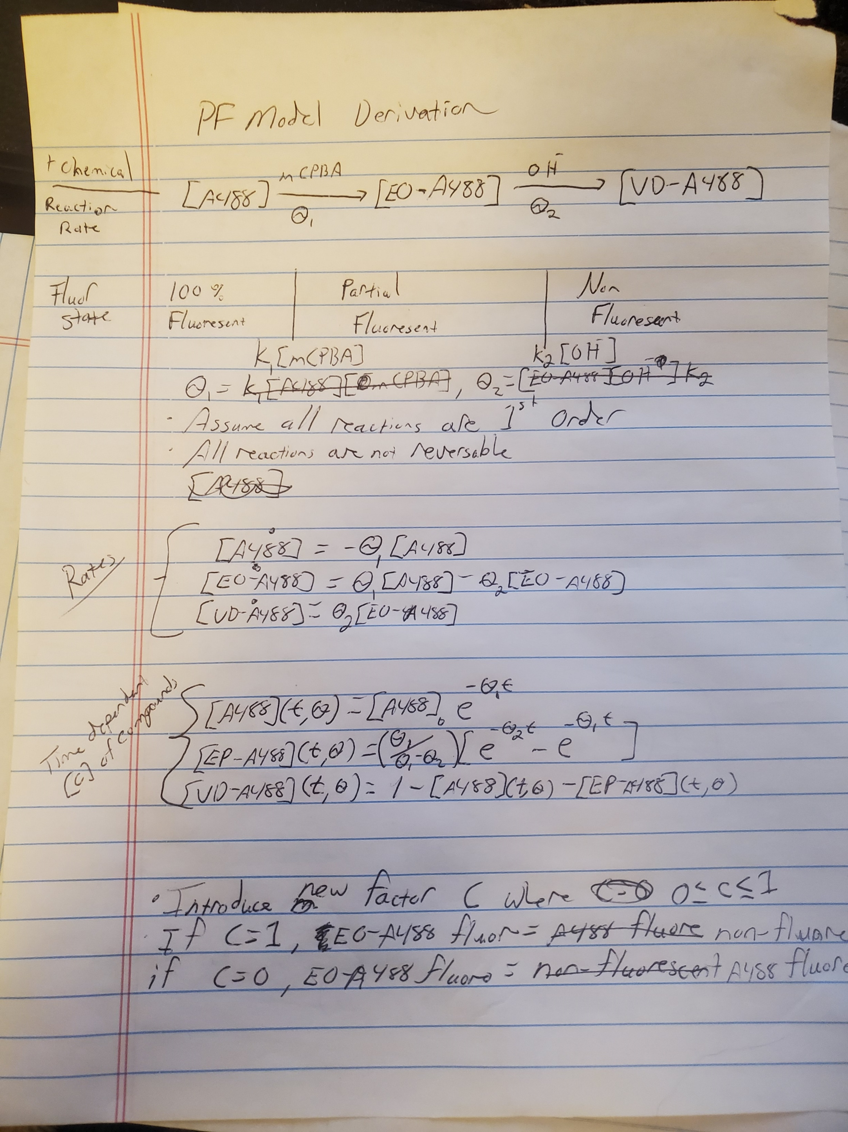
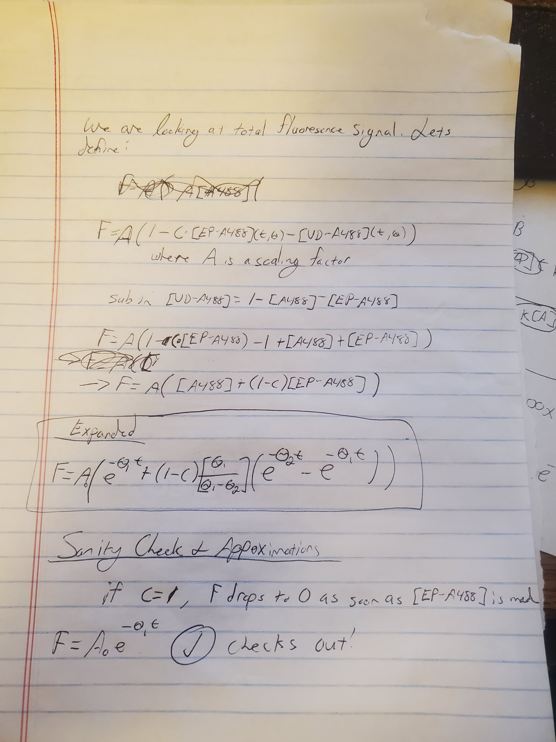
Partial Fluor Model

Slide 23
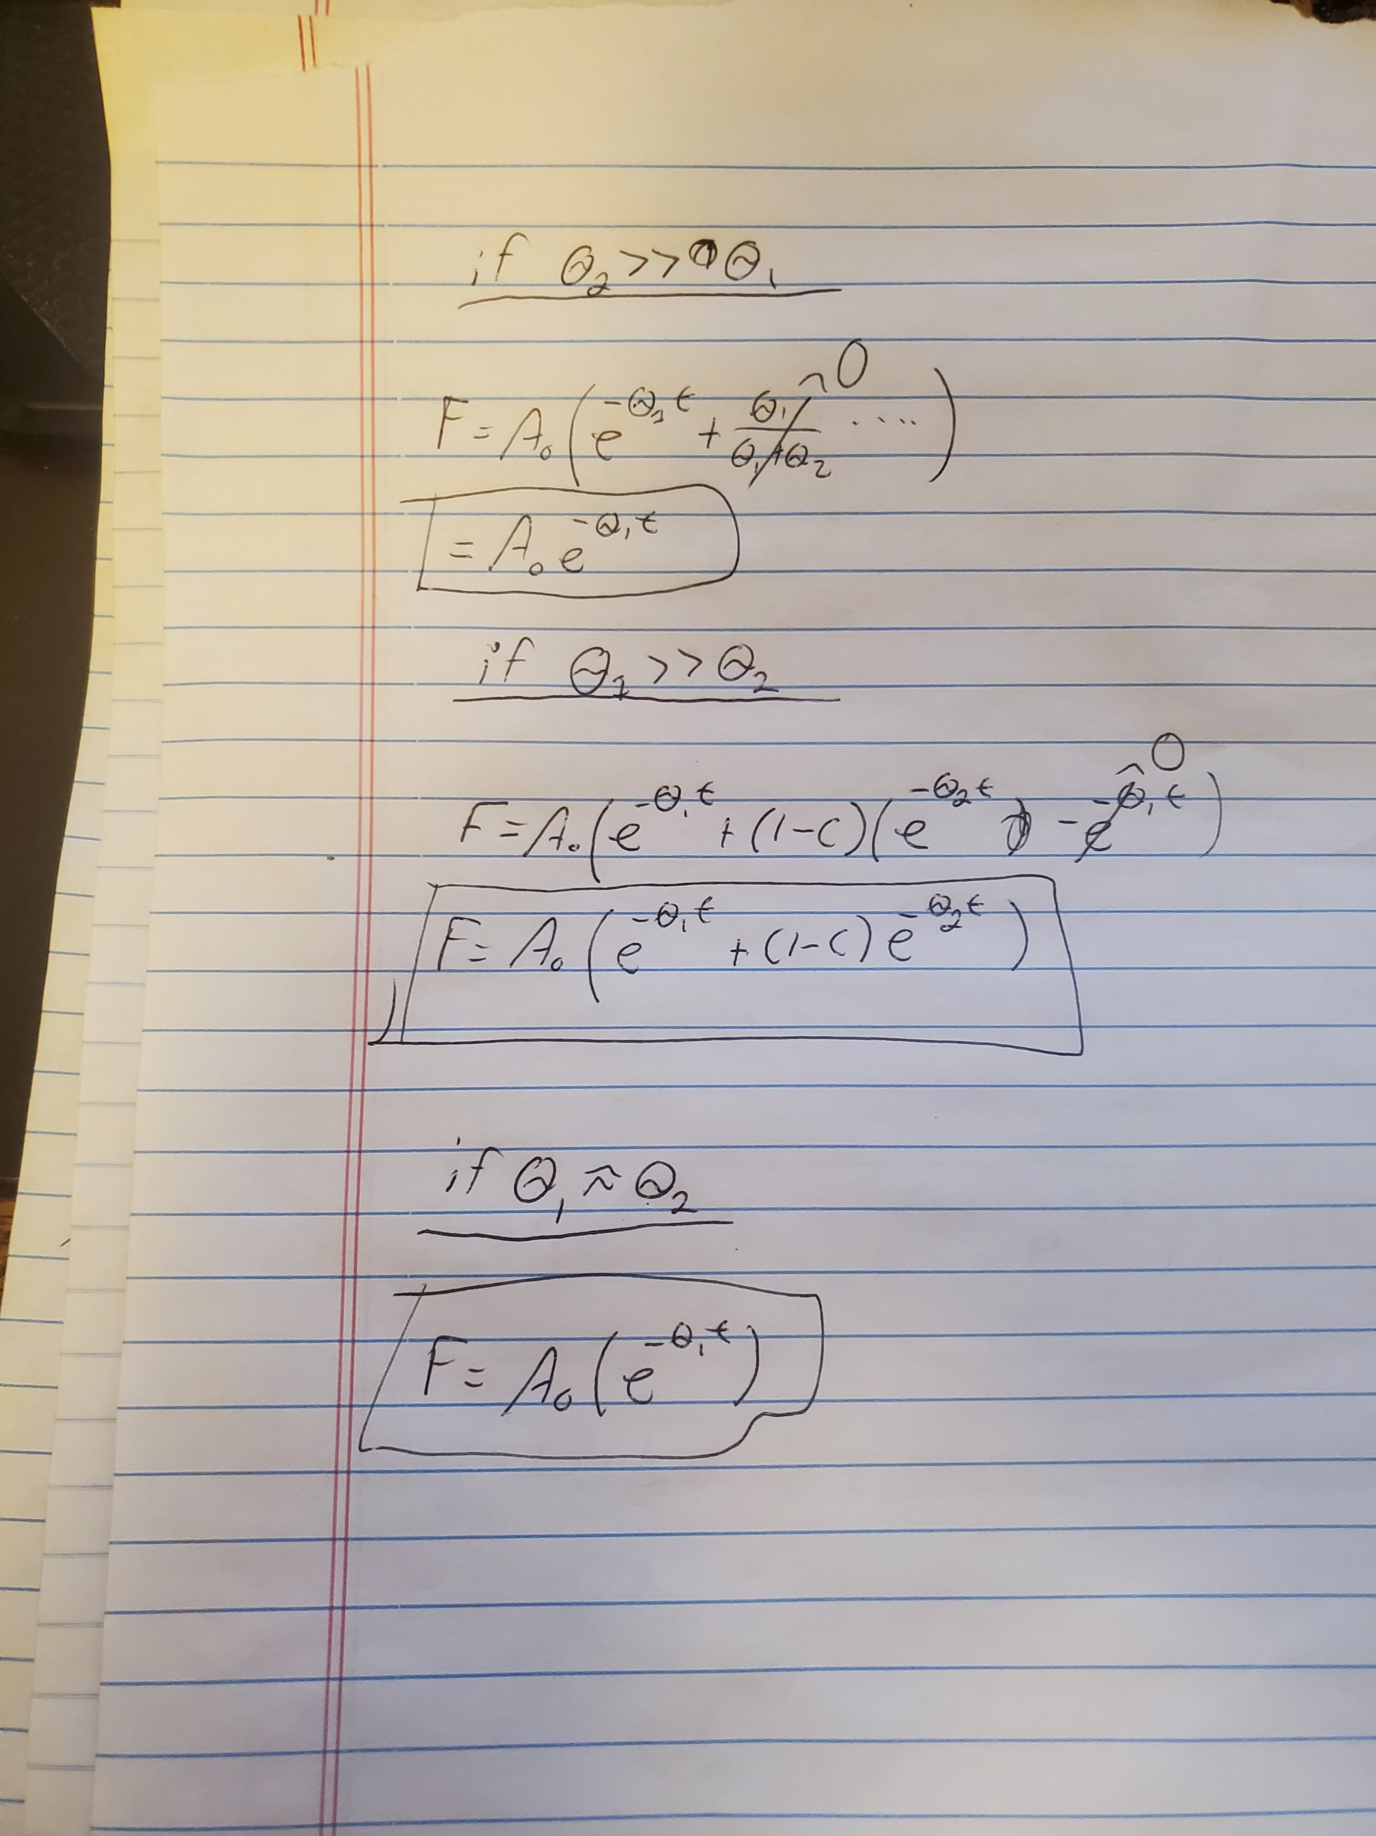
Partial Fluor Approx
Explains Second Decay Term arising

Slide 24
mCPBA vs H2O2 vs H2O2 various dyes

